Slide 1
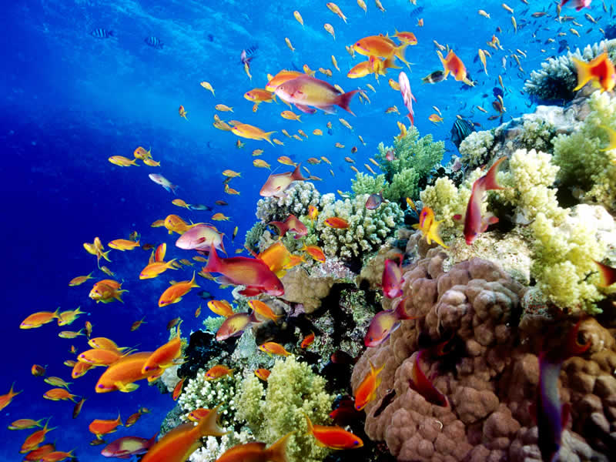
History of Human Interaction with the Great Barrier Reef
Research Proposal

Slide 2
Main Idea
The Great Barrier Reef is the largest living structure on earth, stretching 2300 km long
There has always been a strong interest in the reef, from Aboriginal/Torres Strait Islanders through to modern European Settlers
In recent times, the reef ecosystem has been exploited by fishing, tourism, pollution, shipping
This research project will look at how human activities have changed over time (particularly since the mid 20th century)
Research will investigate the current state of the reef and try to give an indication of what future the reef has with current human actions

Slide 3
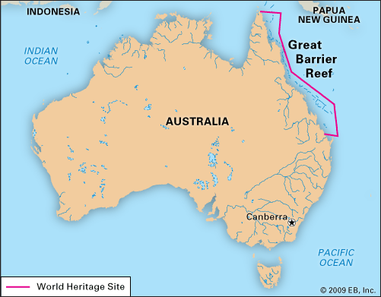
Great Barrier Reef
Covering 344,400 km², the reef is only slightly smaller than the entire size of the baltic sea

Slide 4
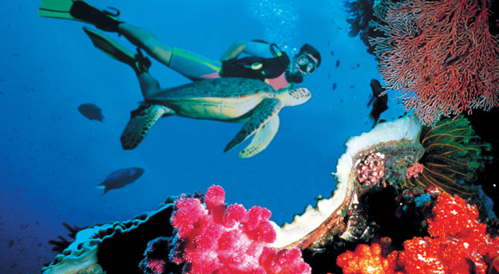
Relevance

Slide 5
Research Questions
When did human interaction with the reef begin?
How has human interaction with the reef changed over time? What has been implemented to protect the area?
Do further constraints need to be put on human activities to protect the reef?

Slide 6
Methodologies
Establish basic environmental/human history history of the reef ecosystem – from Aboriginal use to Modern use
Time scope – focus on 20th century to present
Investigate how legislation has changed regarding the use of the reef
Interviews with GBRPMA, local people to further understand how human interaction has changed (or not changed) and how the reef environment has changed
Compare statistics over time (tourism, fishing)
Investigate current state of reef

Slide 7
Sources
Primary
Secondary
Interviews with GBRMPA, local people
Photographs over time
Statistics from GBRMPA
Plans of Management GBRMPA (comparisons over time)
Great Barrier Reef Outlook Report (comparisons over time)
Sources for Environmental History
The Reef: A Passionate History - Iain McCalman
Great Barrier Reef : History, Science, Heritage – Bowen/Bowen
Source for state of reef
Environmental Studies - Pollution Statistics (Sources, Fates and Consequences of Pollutants in the Great Barrier Reef and Torres Strait)
Newspaper articles/news report

Slide 8
Expected Findings?
Research project should provide an overview of human interaction with the reef and the changes/legislation that have been put in place to regulate conduct with the reef
An idea of what further restrictions need to be placed on human activities in regards to the protection of the ecosystem

